Slide 1
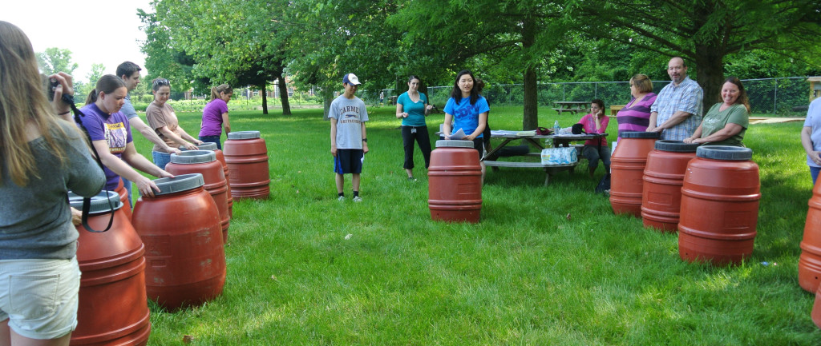
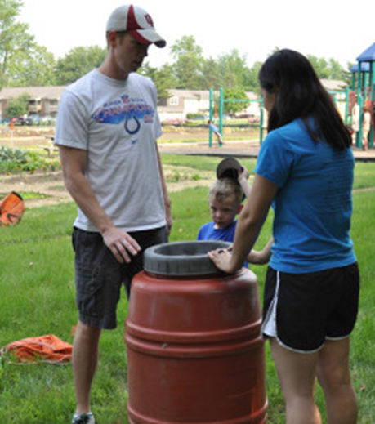
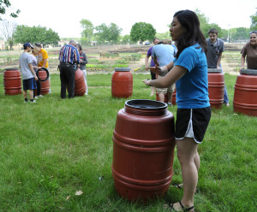
Cut and paste photos and text into this document to create a webpage. Please use a photo editing software to crop images before pasting them to this document.
CHS Teaches to Conserve 2013
Insert a cropped long thin photo of the entire student group doing the project, if possible. Text should include a basic summary of the entire project. – who, what , where, when. Student members of Carmel High School’s Green Team tackled the issues of water and energy conservation through their projects Rain Barrel and Composting Workshops and Switch on the Savings in free community workshops held at the CCS Plots to Plates Community Garden, and in their school.
Next, include text and photos to help tell the story of the project. Include website links or clip art to fill in the story These pics should be cropped to be square-ish before inserting . CHS Green Team students hosted a workshop to teach the participants how to make and utilize rain barrels and how to compost in their gardens to provide community members with the information and tools necessary to conserve valuable resources.
Include the top photo and 6-8 additional photos to help tell the story. Get info from the project application form and project report, or find additional info online. All 20 workshop participants were provided with the necessary materials for to make their own barrels, which they were able to take home after the workshop.

Slide 2
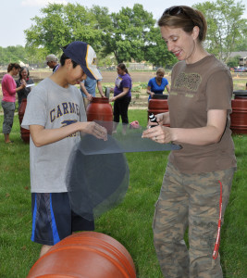
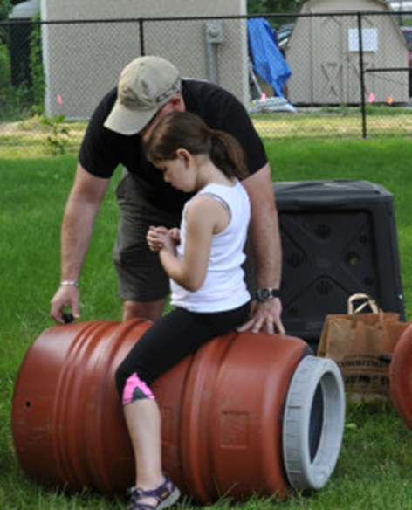
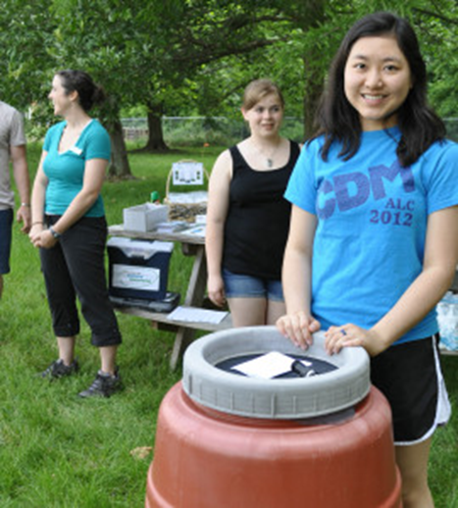
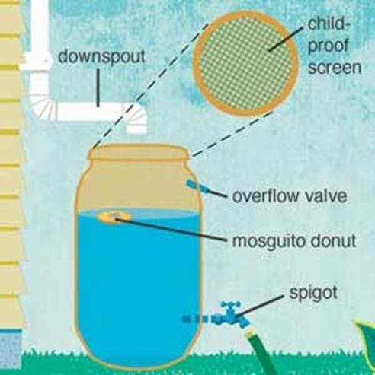
The CHS Green Team would like to thank the following organizations for their donations of time, talent, and supplies to make their project possible: the Carmel Green Teen Micro-Grant Program, the Hamilton County Soil & Water Conservation District, the City of Carmel Stormwater Program, Circle City Rain Barrels, CCS custodian Jerry Bowman, the CCS Plots to Plates Community Garden, and others.
The workshops were attended by young and old alike, and everyone was able to take advantage of this learning opportunity.
A video tutorial on how to build your own Rain Barrel, filmed during the workshop, is available for viewing here. The students estimated that the 20 rain barrels will save up to 50,000 gallons of water annually.
Rain barrels capture water from roofs and therefore prevent water runoff. To learn how to make your own rain barrel and why, click here.

Slide 3
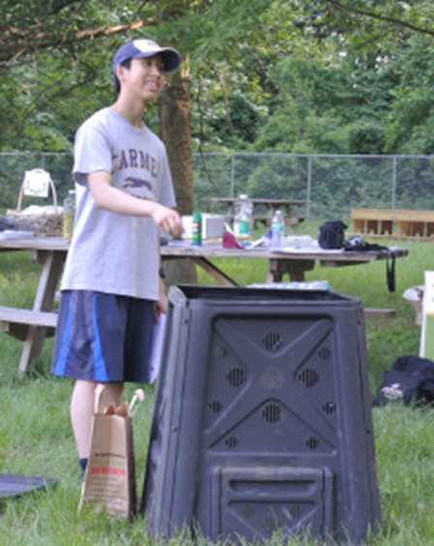
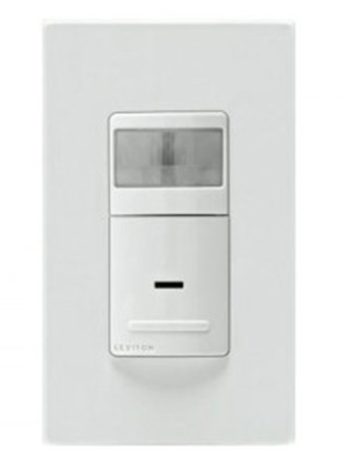
After the conclusion of the Rain Barrel Workshop, the students held a Composting Workshop, describing how to use various types of composters and highlighting the benefits of composting. Each American generates roughly 1,200 lbs of compostable waste yearly. Putting this waste to good use simply makes more sense than using resources to haul it away. For additional information regarding composting, click here.
Conclude with energy savings numbers if possible. The CHS Green Team also had eight light motion sensors installed in representative bathrooms at Carmel High School as a pilot program for the rest of the school. These sensors conserve energy by ensuring that the lights do not remain on for 24 hours each school day. Each light sensor will save 1.444 kilowatt hours per day per restroom.

